Slide 1
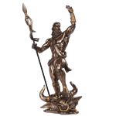

Team “Theseus”
Hybrid Mobile Applications teamwork assignment:
“Theseus Organizer”
Team members:
Hristo Merdjanov - icom85
Georgi Yanakiev – m3tr0n0m3

Slide 2
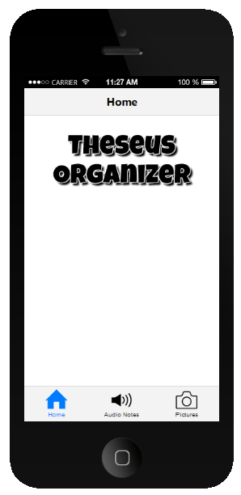
Project Purpose
The purpose of the project is to build a mobile application to keep visual or audio data as notes from a different locations where the user is located. Each file (image or sound) stores the location data as GPS coordinates.

Slide 3





Design and Implementation
Github : https://github.com/TheseusTelerik/TheseusTelerik

Slide 4
Live Demo

Slide 5
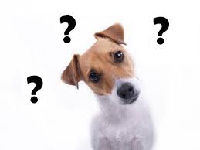

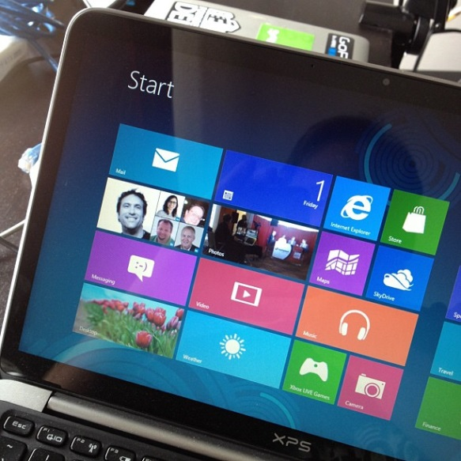
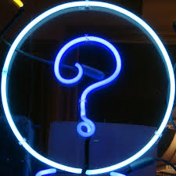
Questions ?
?
?
?
?

